Slide 1
Introduction to R: What is it? Why to use it?
Based on William Ravelle’s Workshop Presentation APS 2015

Slide 2
Key Points
Flexibility
Openness
Automation
Graphics

Slide 3
R: What is it?
R: An international collaboration
R: The open source - public domain version of S+
R: Written by statisticians (and some of us) for statisticians (and the rest of us)
R: Not just a statistics system, also an extensible language.
This means that as new statistics are developed they tend to appear in R far sooner than elsewhere.
R facilitates asking questions that have not already been asked.

Slide 4
What is R?: Technically
R is an open source implementation of S (The statistical language developed at Bell Labs). (S-Plus is a commercial implementation)
R is a language and environment for statistical computing and graphics. R is available under GNU Copy-left
R is a group project run by a core group of developers (with new releases semiannually). The current version of R is 3.4.1
R is an integrated suite of software facilities for data manipulation, calculation and graphical display.
(Adapted from Robert Gentleman and the r-project.org web page)

Slide 5
R is an integrated suite of software facilities for data manipulation, calculation and graphical display. It is:
An effective data handling and storage facility,
a suite of operators for calculations on arrays, in particular matrices,
a large, coherent, integrated collection of intermediate tools for data analysis,
graphical facilities for data analysis and display either on-screen or on hardcopy, and
a well-developed, simple and effective programming language which includes conditionals, loops, user-defined recursive functions and input and output facilities.
“Many users think of R as a statistics system. We prefer to think of it as an environment within which statistical techniques are implemented. R can be extended (easily) via packages ... Available through the CRAN family of Internet sites covering a very wide range of modern statistics." (Adapted from r-project.org web page)

Slide 6
R: A brief history
• 1991-93: Ross Dhaka and Robert Gentleman begin work on R project for Macs at U. Auckland (S for Macs).
1995: R available by ftp under the General Public License.
96-97: mailing list and R core group is formed.
2000: John Chambers, designer of S joins the Rcore (wins a prize for best software from ACM for S)
2001-2015: Core team continues to improve base package with a new release every 6 months (now more like yearly).
Many others contribute “packages" to supplement the functionality for particular problems.

Slide 7
Other Approaches
General purpose programs
R
S+
SAS
SPSS
STATA
Systat
Specialized programs
Mx
EQS
AMOS
LISREL
MPlus
Your favorite program

Slide 8
Other Approaches
General purpose programs
R
$+
$A$
$P$$
$TATA
$y$tat
Specialized programs
Mx
EQ$
AMO$
LI$REL
MPlu$
Your favorite program

Slide 9
R as a way of facilitating replicable science
R is not just for statisticians, it is for all research oriented psychologists.
R scripts are published in psychology journals to show new
methods:
Psychological Methods
Psychological Science
Journal of Research in Personality
R based data sets are now accompanying journal articles:
R code in supplements
Open science framework:
github uploads
OSF uploads
By sharing our code and data the field can increase the possibility of doing replicable science.

Slide 10
R: A way of thinking
“R is the lingua franca of statistical research. Work in all other languages should be discouraged."
“This is R. There is no if. Only how."
“Overall, SAS is about 11 years behind R and S-Plus in statistical capabilities (last year it was about 10 years behind) in my estimation.“
Q: My institute has been heavily dependent on SAS for the past while, and SAS is starting to charge us a very deep amount for license renewal.... The team is [considering] switching to R, ... I am talking about the entire institute with considerable number of analysts using SAS their entire career. ... What kind of problems and challenges have you faced?
A: One of your challenges will be that with the increased productivity of the team you will have time for more intellectually challenging problems. That frustrates some people."

Slide 11
R is open source, how can you trust it?
Q: “When you use it [R], since it is written by so many authors, how do you know that the results are trustable?"
A: “The R engine [...] is pretty well uniformly excellent code but you have to take my word for that. Actually, you don't. The whole engine is open source so, if you wish, you can check every line of it. If people were out to push dodgy software, this is not the way they'd go about it."
Q: Are R packages bug free?
A: No. But bugs are fixed rapidly when identified.
Q: How does function x work? May I adapt it for my functions.
A: Look at the code. Borrow what you need.

Slide 12
Misconception: R is hard to use
R doesn't have a GUI (Graphical User Interface)
Partly true, many use syntax.
Partly not true, GUIs exist (e.g., R Commander, R-Studio).
Quasi GUIs for Mac and PCs make syntax writing easier.
R syntax is hard to use
Not really, unless you think an iPhone is hard to use.
Easier to give instructions of 1-4 lines of syntax rather than pictures of menu after menu to pull down.
Keep a copy of your syntax, modify it for the next analysis.
Same as recipe cards
R is not user friendly: A personological description of R
R is Introverted: it will tell you what you want to know if you ask, but not if you don't ask.
R is Conscientious: it wants commands to be correct.
R is not Agreeable: its error messages are at best cryptic.
R is Stable: it does not break down under stress.
R is Open: new ideas about statistics are easily developed.

Slide 13
Misconceptions: R is hard to learn Some interesting facts
With a brief web based tutorial http://personality-project.org/r, 2nd and 3rd year undergraduates in psychological methods and personality research courses are using R for descriptive and inferential statistics and producing publication quality graphics.
More and more psychology departments are using it for graduate and undergraduate instruction.
R is easy to learn, hard to master
R-help newsgroup is very supportive (usually)
Multiple web based and pdf tutorials see (e.g., http://www.r-project.org/)
Short courses using R for many applications.
APS workshops
Statistical Horizons
Temple Grad Psych Courses (roll out ???)
Books and websites for SPSS and SAS users trying to learn R (e.g., http://r4stats.com/) by Bob Muenchen (look for link to free version).

Slide 14
Various ways to run R
1. UNIX (and *NIX like) environments
Can be scripted for use on remote servers
Particularly fast if on remote processors with many cores
RStudio Server as “Integrated Development Environment“ (IDE)
RStudio can be run remotely with a browser (e.g., even from an IPad)
PC
quasi GUI + text editor of choice
RStudio as “Integrated Development Environment" (IDE)
Mac
R.app + text editor of choice
RStudio as “Integrated Development Environment" (IDE)

Slide 15
Ok, how do I get it: Getting started with R
Installed on all Temple Computers
Download from R Cran (http://cran.r-project.org/)
Choose appropriate operating system and download compiled R
Install R (current version is 3.2.0) (See a tutorial on how to install R and various packages at http://personality-project.org/r/psych)
Start R
Add useful packages (just need to do this once)
install.packages("ctv") #this downloads the task view package
library(ctv) #this activates the ctv package
install.views("Psychometrics") #among others
Take a 5 minute break
Activate the package(s) you want to use today (e.g., psych)
library(psych) #necessary for most of today's examples
Use R

Slide 16
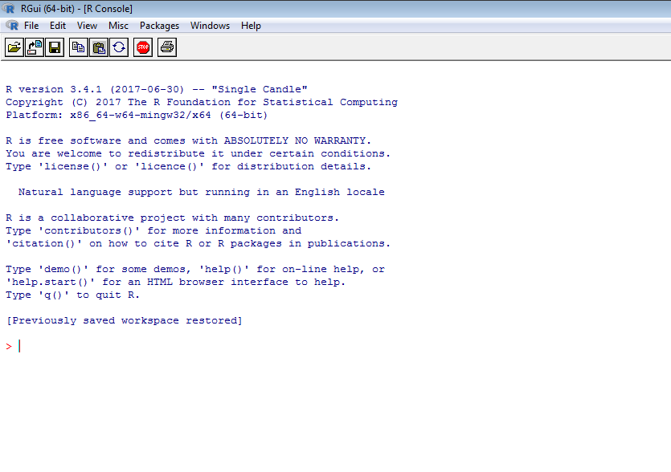
R Application
Text input for syntax commands

Slide 17
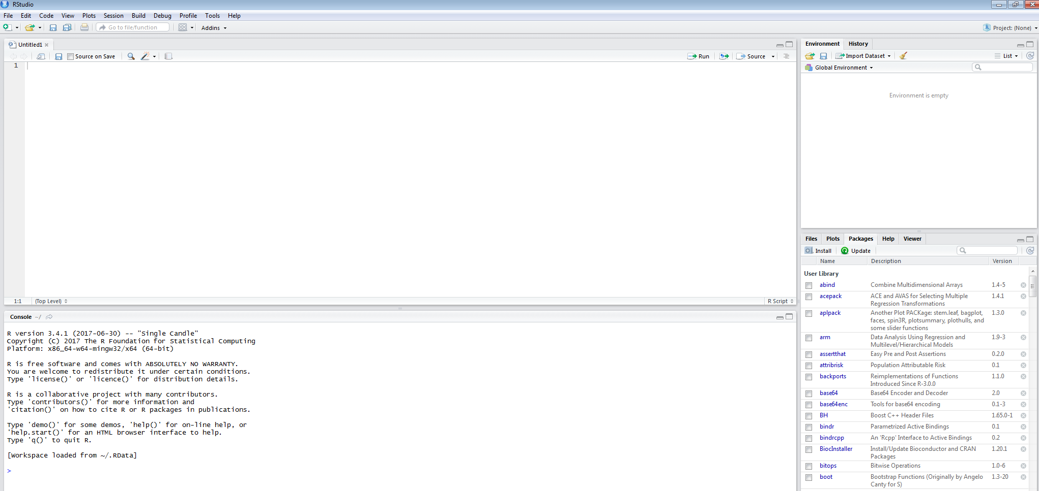
R Studio

Slide 18
R Studio Elements
Script Editor
Permits development, testing, and saving of syntax
Console
Presents executed commands that have gone through R
Identifies successful commands
Provides error messages

Slide 19
R Studio Elements
Environment
Tracks information in R’s working memory
Data frames (i.e., datasets)
R Objects
Lists of information
Quick links
Files in working directory
Available plots
Available Packages
Help (links to cheat sheets)

Slide 20
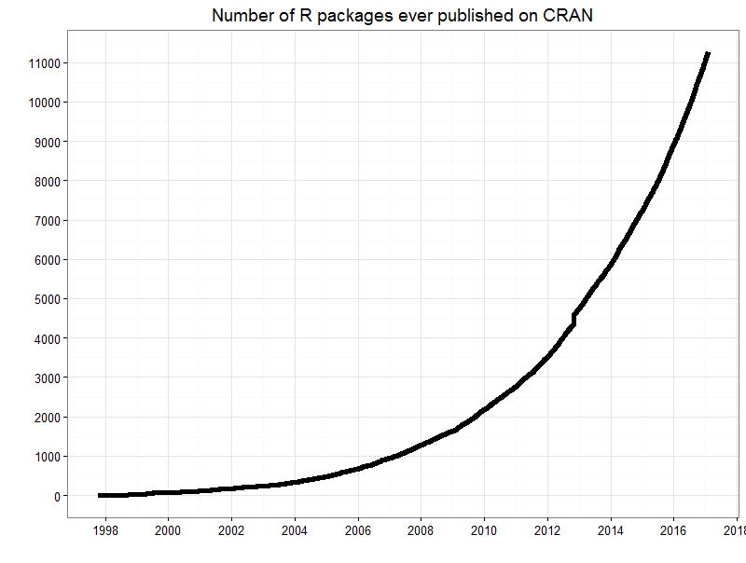
Modularity of R
https://gist.github.com/daroczig/3cf06d6db4be2bbe3368

Slide 21
A small subset of very useful packages
General use
core R
MASS
lattice
lme4 (core)
psych
Zelig
Special use
ltm
sem
lavaan
OpenMx
GPArotation
mvtnorm
> 5,500 known
General applications
most descriptive and inferential stats
Modern Applied Statistics with S
Lattice or Trellis graphics
Linear mixed-effects models
Personality/psychometrics general purpose
General purpose toolkit
More specialized packages
Latent Trait Model (IRT)
SEM and CFA (one group - RAM path notation)
SEM and CFA (multiple groups )
SEM and CFA (multiple groups +)
Jennrich rotations
Multivariate distributions
Thousands of more packages on CRAN

Slide 22
A small subset of very useful packages (see also Computer World list)
General use
devtools
readxl
foreign
RMySQL
readr
rio
Special use
dplyr
plyr
data.table
knitr
sweave
ggplot2
> 5,500 known
General applications
Get packages from GitHub
input from excel
input from SPSS, etc.
input from MySQL
fast input for very large csv files
simple to use integrated input/output
More specialized packages
reshape from wide to long etc.
reshape
faster data handling for large data sets
integrate markdown documentation with R
integrate LATEXdocumentation with R
powerful grammar of graphics
Thousands of more packages on CRAN

Slide 23
Using R for psychological statistics: Basic statistics
Writing syntax
For a single line, just type it
Mistakes can be redone by using the up arrow key
For longer code, use a text editor (built into some GUIs)
Data entry
Using built in data sets for examples
Copying from another program
Reading a text or csv file
Importing from SPSS or SAS
Descriptives
Graphical displays
Descriptive statistics
Correlation
Inferential
the t test
the F test
the linear model

Slide 24
Breadth
Sophisticated data management
Translation/connectivity with many other programs
e.g., command line; ePrime; interphase with other statistics programs
Basic inferential statistics
SEM
HLM
Computational Modeling
Taxometrics
Mixture Modeling
fMRI

Slide 25
For us SPSS people…
There are several different packages that make importing SPSS, SAS, Systat, etc. files easy to do.
foreign:
read data stored by Minitab, S, SAS, SPSS, Stata, Systat, Weka, dBase. Comes installed with R.
Somewhat complicated syntax.
haven:
Reads/writes SPSS and Stata les. Handles SPSS labels nicely (keeps the item labels, but converts the data to factors).
rio:
A general purpose package that requires installation of many of the other packages used for data import.
Easiest to use, but overkill if just reading in one type of file. Basically a front end to many import/export packages. It determines which package to use based upon the file name sux (e.g., csv, txt, sav, ...)

Slide 26
Read a “foreign" le e.g., an SPSS sav file, using foreign package
read.spss Reads a file stored by the SPSS save or export commands. (The defaults lead to problems, make sure to specify that you want use.value.labels = FALSE, to.data.frame = TRUE)
read.spss(file, use.value.labels = FALSE, to.data.frame = TRUE, max.value.labels = Inf, trim.factor.names = FALSE, trim_values = TRUE, reencode = NA, use.missings = to.data.frame)
file: Character string: the name of the le or URL to read.
use.value.labels: Convert variables with value labels into R factors with those levels?; Should be FALSE
to.data.frame return a data frame? Defaults to FALSE, probably should be TRUE in most cases.
max.value.labels Only variables with value labels and at most this many unique values will be converted to factors if use.value.labels = TRUE.
trim.factor.names Logical: trim trailing spaces from factor levels?
trim values logical: should values and value labels have trailing spaces ignored when matching for use.value.labels = TRUE?
use.missings logical: should information on user-dened missing values be used to set the corresponding values to NA?

Slide 27
Simple Example
library(foreign)
bfidata = data.frame(read.spss("C:/Users/tuf22063/Dropbox/R Talk/BFI Data/BFI Example Data.sav", use.value.labels = FALSE, to.data.frame = TRUE))
describe(bfidata)
headTail(bfidata)
boxplot(bfidata[2:6])
pairs.panels(bfidata[2:6])

Slide 28
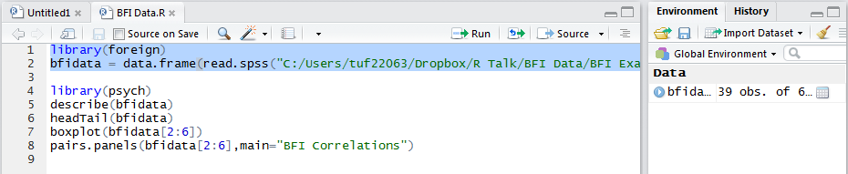
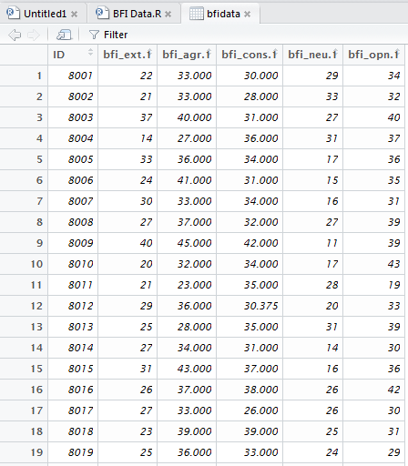
Data entered?

Slide 29
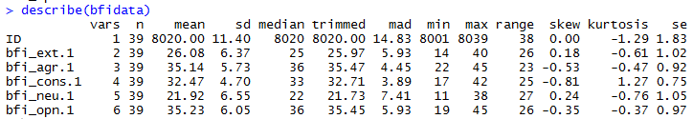
Simple Example
describe(bfidata)

Slide 30
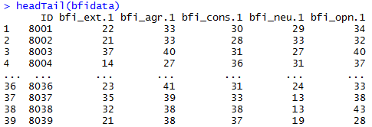
Simple Example
headTail(bfidata)

Slide 31
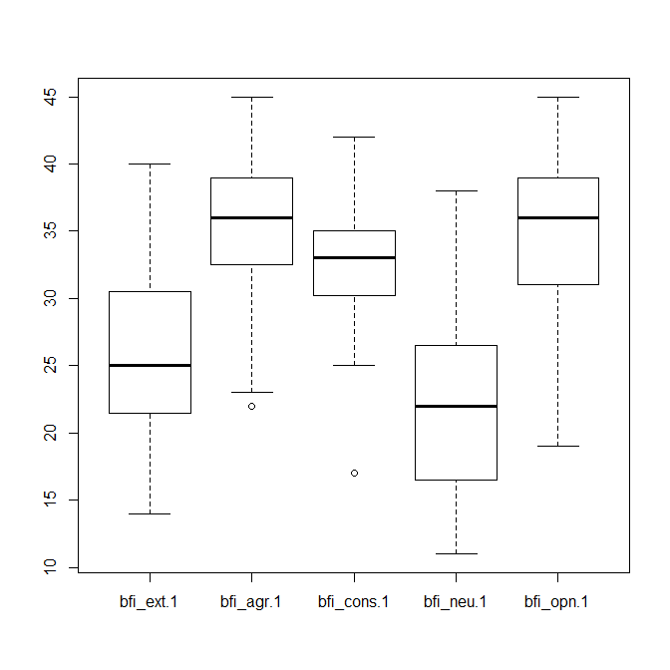
Simple Example
boxplot(bfidata[2:6])

Slide 32
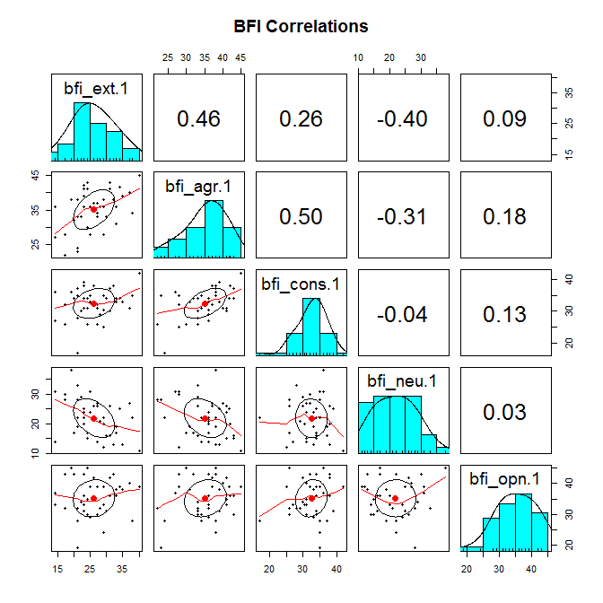
Simple Example

Slide 33
Automation
Programming permits expedited evaluation of multiple models
Can be extended to summarizing results

Slide 34
Worked Example
Examine sub-populations based on lifetime patterns of mental illness
Use latent class analysis
An iterative analytic approach
Estimate models for 1-7 different groups
Evaluate model fit across multiple statistical indices
Visualize group characteristics

Slide 35
LCA Demo
OADP LCA Demo Script.r
96 total lines of code

Slide 36
LCA Demo
library(MplusAutomation)
Activate MplusAutomation package
createModels("C:/Users/tuf22063/Dropbox/R Talk/LCA/Create Models Syntax.txt")
Create Mplus input files using R for estimating analyses with 1-7 classes
runModels("C:/Users/tuf22063/Dropbox/R Talk/LCA", recursive=FALSE)
Run all models in the noted directory

Slide 37
LCA Demo
OADP_LCA_Summary<- readModels("C:/Users/tuf22063/Dropbox/R Talk/LCA", recursive=TRUE)
Create a summary of all model information in the noted directory
HTMLSummaryTable(OADP_LCA_Summary, filename="C:/Users/tuf22063/Dropbox/R Talk/LCA/OADP LCA Summary.html", display=TRUE, keepCols=c("Title", "LL", "AIC", "BIC", "aBIC", "AICC", "Parameters"), sortBy="Parameters")
Create a HTML file with the noted information

Slide 38
LCA Demo
Lines 13-89
Create summary plots to visualize classes
Lines 91-96
Save each plot as a separate pdf

Slide 39
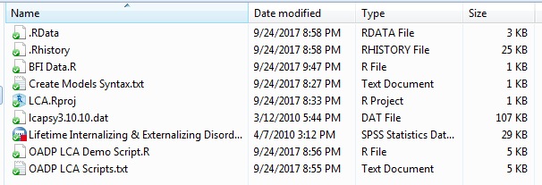
Before Running the Full Script

Slide 40
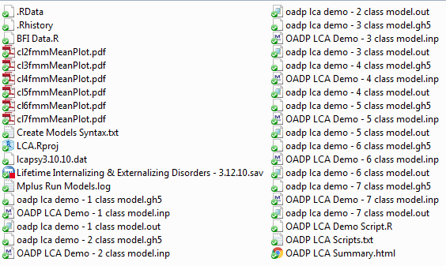
After Running the Full Script

Slide 41
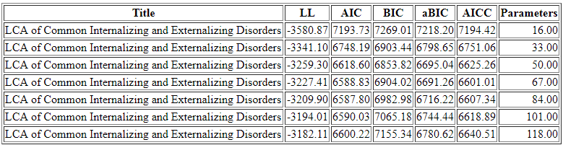
Model Fit Summary

Slide 42
Plots
2 Class Solution
3 Class Solution
4 Class Solution
5 Class Solution
6 Class Solution
7 Class Solution

Slide 43
Remainder of the Semester
Statistical Computing in R: Why Learn to Use It? A Teaser
Statistical Computing in R: Getting Started – October 9; 4-5pm: David Waxler
Statistical Computing in R: Common Analyses for the Social Sciences – October 23 from 3:30-4:30pm: Josh Klugman
Statistical Computing in R: Visualizing Data – December 11 from 2:30-3:30pm: Dave Smith

